Slide 1
User Manual
Student Course Registration Application
Team-1 Aug 1st. 2020

Slide 2
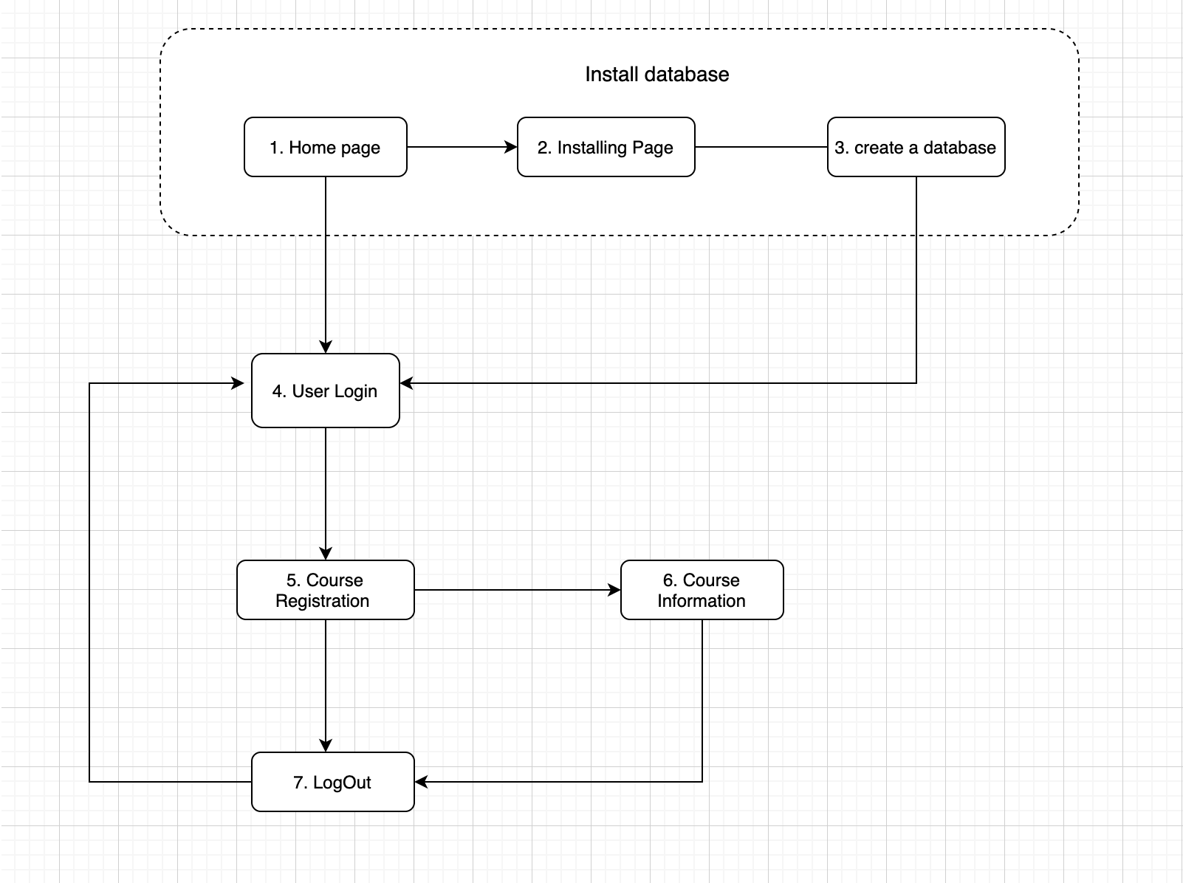
Main user flow chart
Our database consists of five entities, but our fully implemented CRUD are only for students, student_courses and tuition
Student_Courses
Students
Tuition
Courses (read-only)
Instructors (read-only)

Slide 3
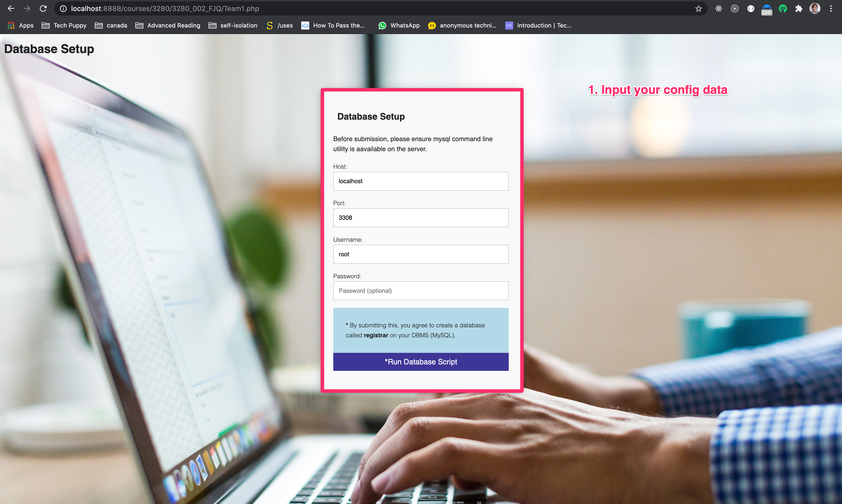
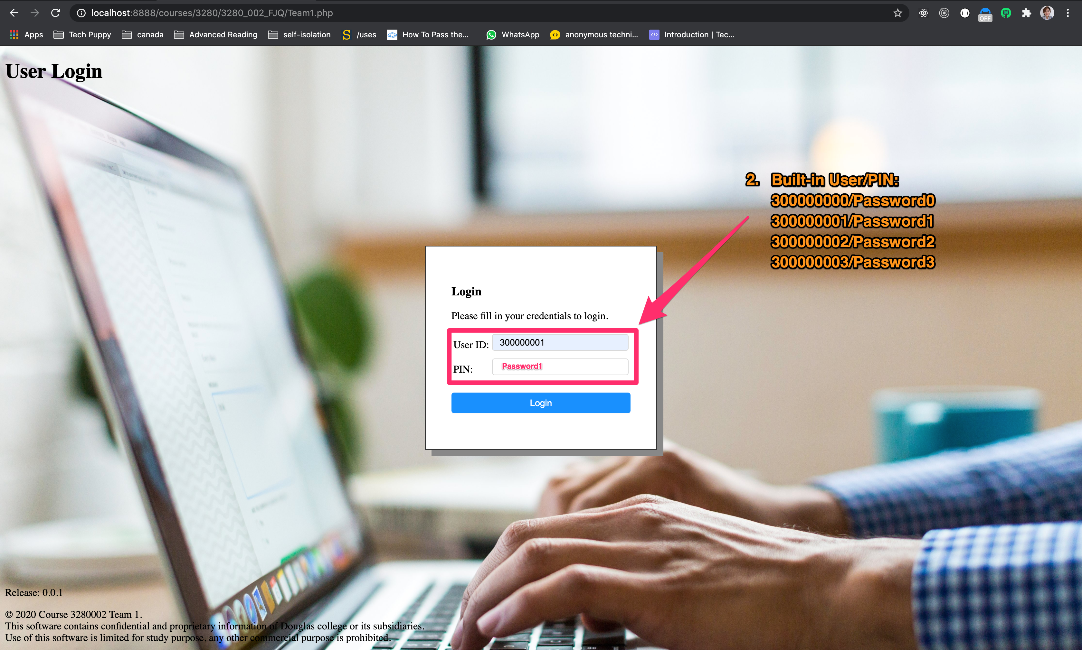
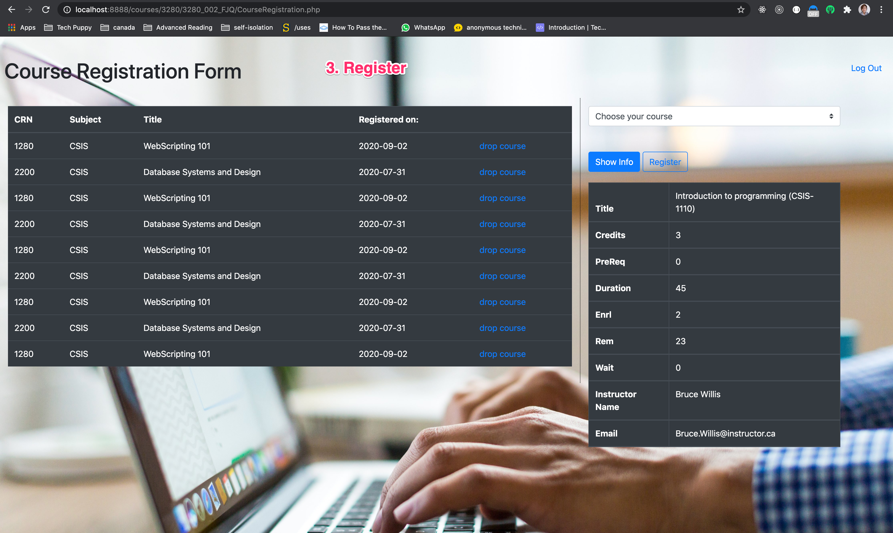

Getting Started

Slide 4
Register Actions
[your server path]/Team1.php;
Input your config of database, eg. host, post, etc;
Log in the system; (300000001/Password1);
Register courses;
Show information about what you have chosen;
Log out the system;

